Slide 1
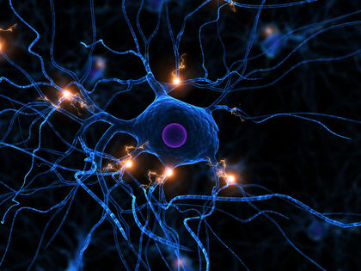
Deep Learning for Sentiment Analysis: Case Studies
Francesco Pugliese, PhD
Italian National Institute of Statistics, Division "Information and Application Architecture“, Directorate for methodology and statistical design
Email Francesco Pugliese : neural1977@gmail.com

Slide 2
Case Study: Sentiment Analysis for Economy
Nowadays more and more people are using Social Media platforms to find out news, to express their feelings and to share or debate opinions about virtually every possible topic
The interest towards Social Media as a means for “measuring” public’s mood is still growing
We are investigating whether social media messages may be successfully exploited to develop domain-specific sentiment indices. The aim is to assess the Italian mood about specific topics or aspects of life, e.g.
the economic situation, the European Union, the migrants’ phenomenon, the terrorist threat, and so on
These new indices would enable high-frequency (e.g. daily) measures of the Italian sentiment about phenomena which are of interest in Official Statistics
The hope is that such indices could either improve the performance of forecasting models, or enrich existing statistical products (e.g. the BES), or even be disseminated as new statistical outputs in their own right

Slide 3






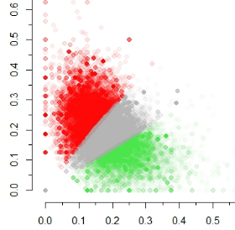
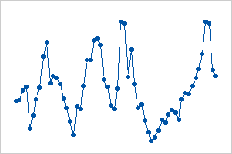
Processing Pipeline at a Glance
Twitter
Public
Stream
‘Social Mood
on Economy’
Filter
Filtering
Italian
Sentiment
Lexicon
Surveillance System
Outlier Detection
and Imputation
Sentiment Scoring
Clustering
Daily Index
Computation
Author: Diego Zardetto

Slide 4
Data Collection and Storage
Data Collection Technique
We exploit Twitter’s Streaming API to get low latency access to Twitter’s firehose and collect samples of public tweets
Target Population
Public tweets whose text matches at least one keyword belonging to the filter
Sampling Design
The sampling algorithm is a black box, as it is entirely controlled by Twitter’s Streaming API. At most a 1% of all the tweets produced on Twitter at a given time can be sampled
Data Format
Twitter’s Streaming API returns data in JSON format
Data Staging and Storage
We temporarily store gathered JSON data as text files inside a staging area residing on a server. Then we periodically load bunches of tweets into an Oracle DB (and remove the corresponding files from the staging area)

Slide 5
Text Processing and Sentiment Analysis
Process Granularity
To compute daily index values, we process all the tweets collected in a single day as a single block
Input Data
We only analyze the textual content of the tweets. (No information about users is ever accessed: the index only uses unlinked anonymized data)
Text Cleaning and Normalization
We perform standard NLP pre-processing steps: (i) convert to lowercase,
(ii) tokenize running text into words, (iii) apply basic orthographic repairs,
(iv) remove URLs, (v) remove non-alphabetic characters (e.g. ‘#’ or ‘@’),
(vi) remove stop words, (vi) if needed, stem words to get rid of inflected forms
Sentiment Analysis Approach
To classify tweets as Positive, Negative or Neutral we chose to adopt an unsupervised, lexicon-based approach
We discarded supervised, Machine Learning approaches because we were unable to find large, high quality training sets of human-labeled tweets in Italian

Slide 6
Sentiment Scores: The Lexicon
Our Sentiment Analysis application involves two sequential steps
Calculate sentiment scores for each tweet
Use these sentiment scores to cluster tweets into three mutually exclusive classes: Positive (P), Negative (N) and Neutral (U)
To attach sentiment scores to a tweet we leverage an Italian Sentiment Lexicon, namely a vocabulary whose lemmas are associated to pre-computed positive and negative sentiment scores
Currently we are using the Sentix lexicon [Basile and Nissim 2013]
Since it aligns several existing, independent lexical resources (WordNet, MultiWordNet, BabelNet, SentiWordNet) Sentix contains many duplicated lemmas
~75’000 lemmas overall, only ~42’000 unique
To ensure unambiguous and reproducible results we de-duplicated Sentix by averaging atomic sentiment scores of duplicated lemmas

Slide 7
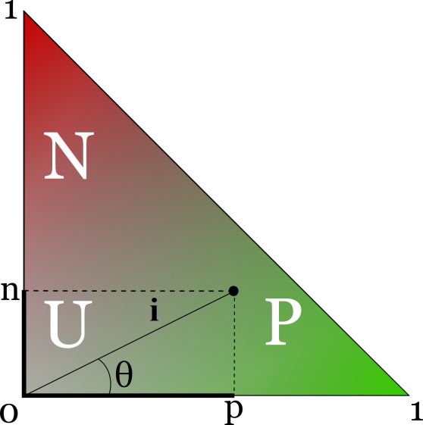
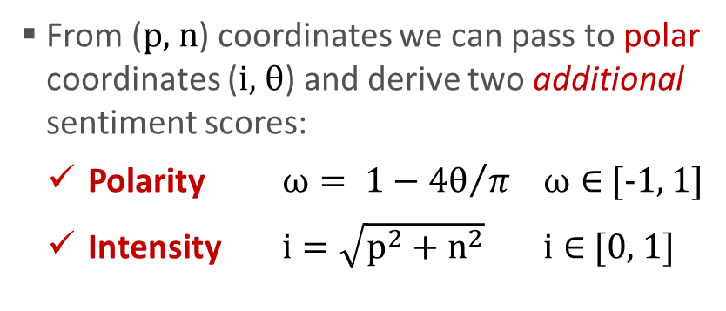
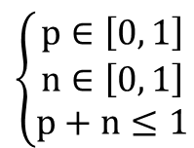
The Sentiment Space
$$\left\{\begin{matrix}p∈\left[0, 1\right] \\ n∈\left[0, 1\right] \\ p+n≤1\end{matrix}\right.$$
In Sentix, positive (p) and negative (n) sentiment
scores of lemmas are constrained as follows:
Therefore Sentix maps lemmas to points
belonging to the sentiment triangle:
From (p, n) coordinates we can pass to polar coordinates (i, θ) and derive two additional sentiment scores:
Polarity $ω= 1−{4θ}/π$ $ω∈$ [-1, 1]
Intensity $i=\sqrt{p^{2}+n^{2}}$ $i∈$ [0, 1]
lemma | pos | neg | polarity | intensity
caldo | 0.25 | 0.125 | 0.41 | 0.28
freddo | 0.047 | 0.297 | -0.8 | 0.3
This way Sentix lemmas are
mapped to a 4D sentiment space
To enable clustering, tweets too must be mapped to this 4D space

Slide 8

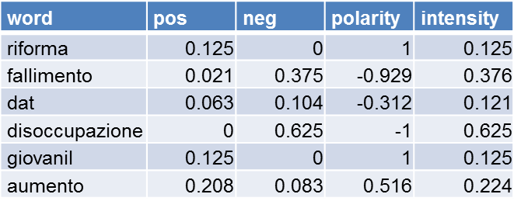

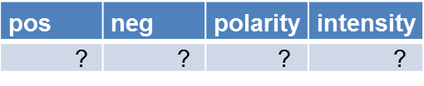
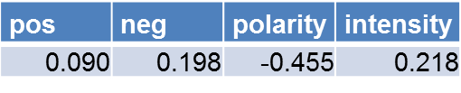
From Word-level to Tweet-level Sentiment Scores
1
disoccupazione
negative score
fallimento
dat
aumento
giovanil
0
riforma
1
positive score

Slide 9
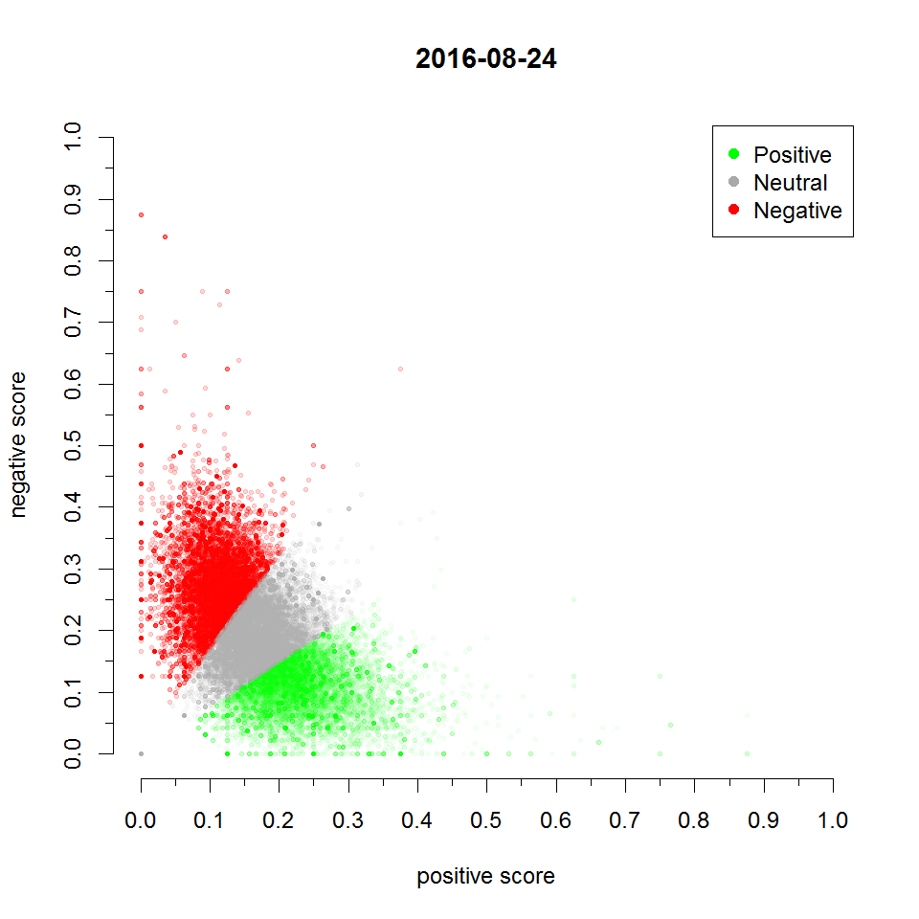
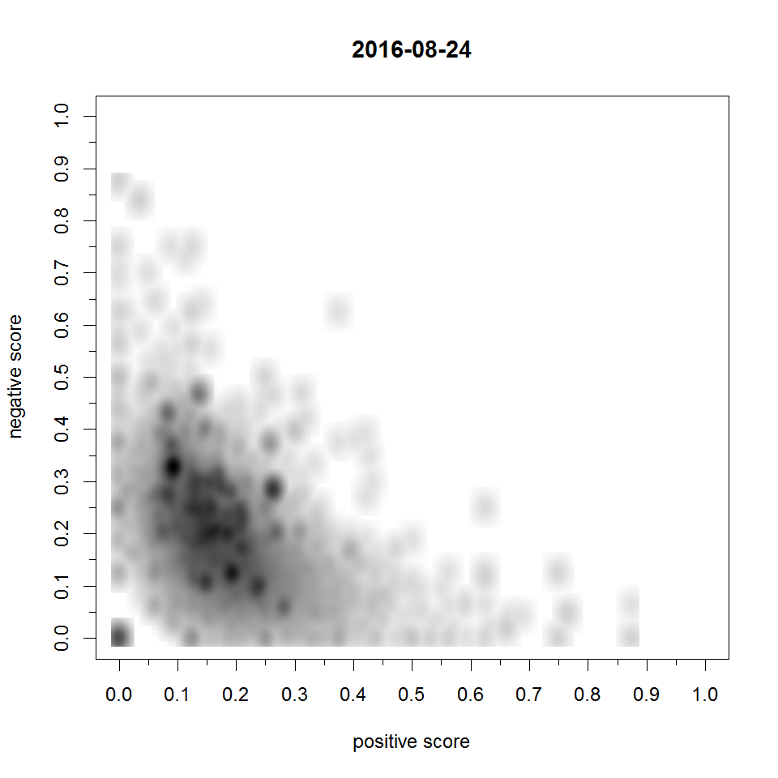
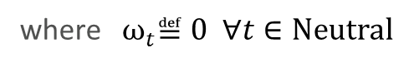
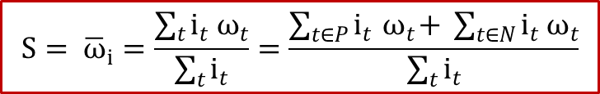
Clustering and Calculation of the Index
Once sentiment scores (p, n, ω, i) are available for all the tweets of a daily block…
…we use K-means to cluster them into Positive, Negative and Neutral tweets
to lower the risk of finding a local optimum, we run it 100 times with random starts and pick the best solution
Lastly we compute the daily index value (S), which depends on the distribution of tweets within the Positive, Neutral and Negative classes
$$S= {\overline{ω}}_{i}=\frac{\sum_{t}{i_{t}{ ω}_{t}}}{\sum_{t}{i_{t}}}=\frac{\sum_{t∈P}{i_{t}{ ω}_{t}+ }\sum_{t∈N}{i_{t}{ ω}_{t}}}{\sum_{t}{i_{t}}}$$
where ${ ω}_{t}≝0 ∀t∈Neutral$
This index can be seen as the average of polarity (ω) weighted by intensity (i), provided we treat Neutral tweets as if their polarity were zero. Compared to traditional alternatives:
It is more resilient to tweets’ misclassification
It reduces day-to-day volatility

Slide 10
Monitoring and Validation
No filter is perfect! Thus we devoted special care to make the index robust against possible contaminations by off-topic tweets that might pass the filter
We developed a surveillance system, which periodically searches for anomalous values in the daily time series by means of two independent and complementary outlier detection routines
Daily values detected as potential outliers cause the system to generate a set of automated diagnostic reports
These are then sent to human reviewers in charge of deciding whether the detected values are actually proper data points, or instead truly anomalous
Truly anomalous data typically arise when an off-topic tweet that happened to pass the filter becomes “viral” on Twitter
Being re-twitted and quoted thousands of times in a day, viral tweets may have an unduly impact on the daily index and introduce bias
All the daily index values classified as truly anomalous are eventually imputed via nearest-neighbor interpolation

Slide 11
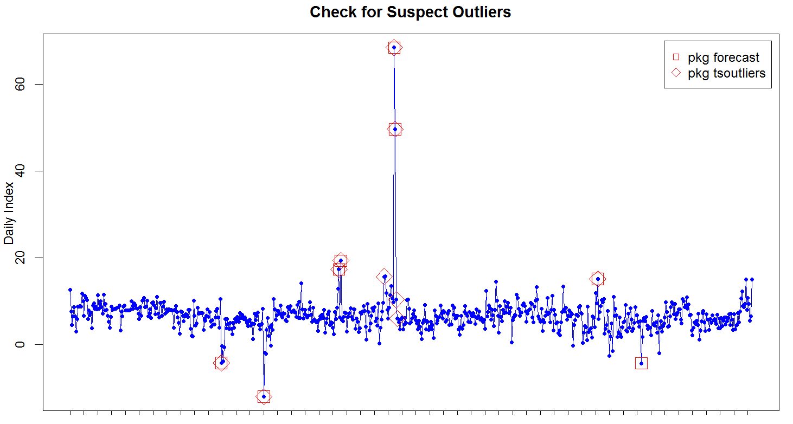
Anomalous Values: One Example
Day: 3 Jan 2017
Value: 69
Event: ???
Day: 24 Aug 2016
Value: -12
Event: Earthquake

Slide 12


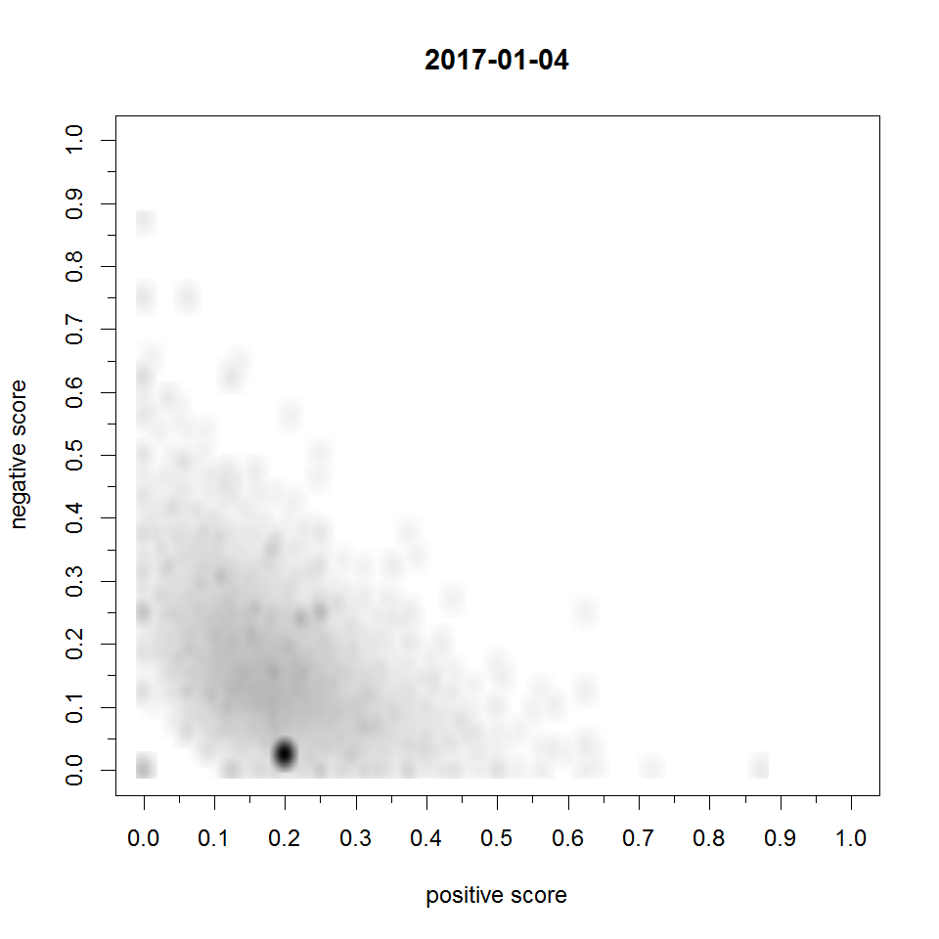
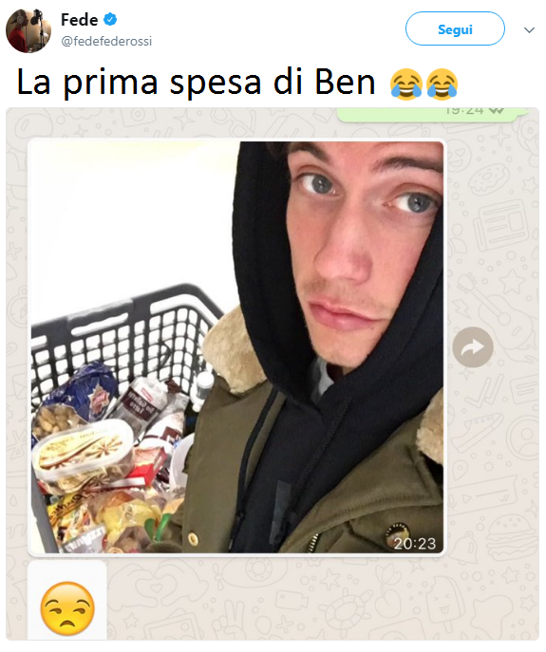
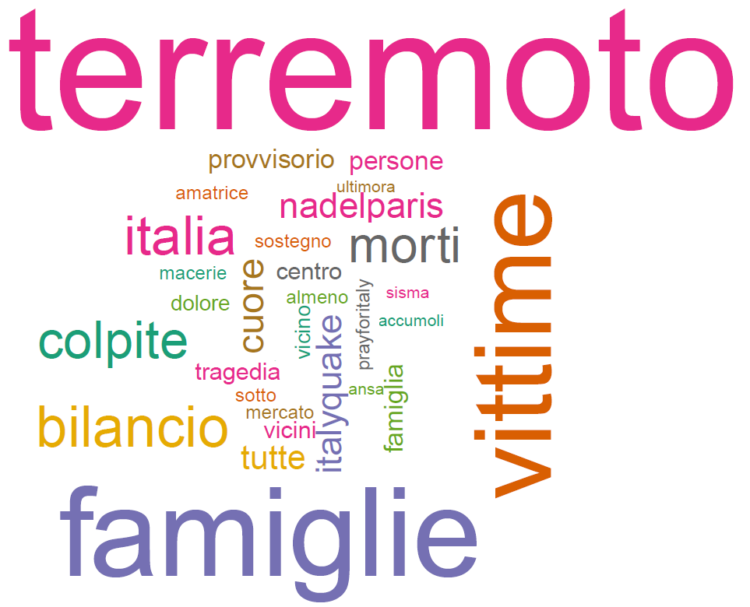
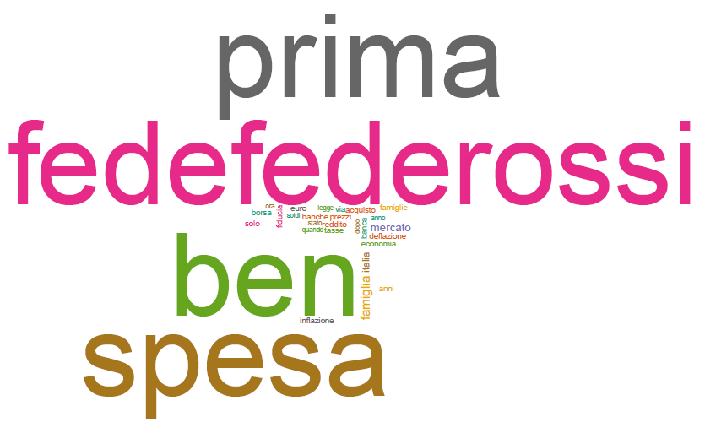
24 Aug 2016
3 Jan 2017

Slide 13
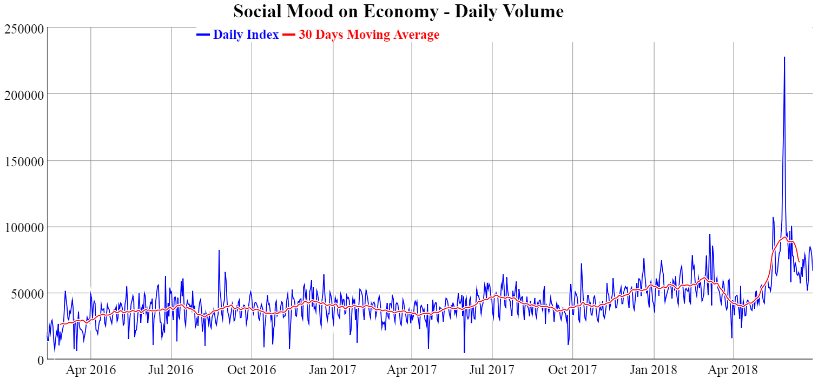
Volume Burst in 2018 Post-Election Crisis
29 May 2018
Spread Peaks Above 300 bps
230,000 tweets
16 May 2018
“Italy will ask the ECB a debt write-off of 250 billion €”
110,000 tweets
5 March 2018
Political Election Results
95,000 tweets

Slide 14
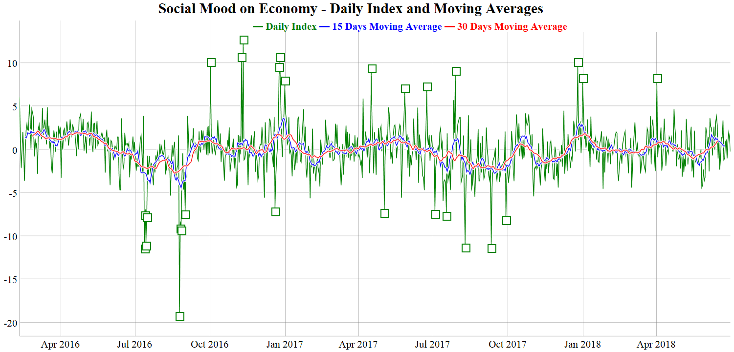
Valleys: Disasters and Terrorism
Disasters
Central Italy Earthquake
Livorno Flood
Andria-Corato Train Collision
Terrorism
Truck Attack in Nice
Christmas Market Attack in Berlin

Slide 15
Valleys: Welfare and Economy
Welfare and Economy
Poverty
Pension System (women’s)
Unemployment (youth’s!)
Income (youth’s)

Slide 16
Peaks: Welfare and Economy
Welfare and Economy
School Teachers Mobility
Pension System (women’s)
Universal Employment vs Universal Income (Pope Francis)

Slide 17
Peaks: Holidays
Holidays
Christmas and Christmas Eve
New Years’ Eve
Easter

Slide 18
An Interesting Dynamic
Renewal of ‘Women's Option’ Retirement Opportunity
Rejected in 2018 Budget Law

Slide 19
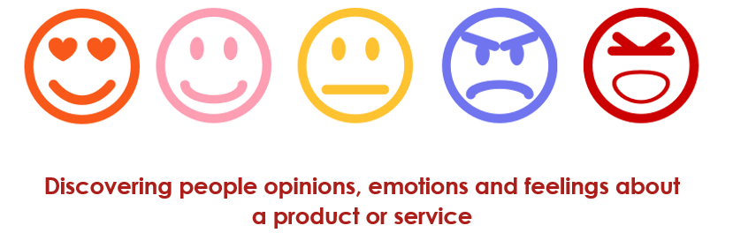
Sentiment Analysis (Ain, et al. 2017)
Sentiments of users that are expressed on the web has great influence on the readers, product vendors and politicians.
Sentiment Analysis refers to text organization for the classification of mind-set or feelings in different manners such as negative, positive, favorable, unfavorable, thumbs up, thumbs down, etc. Thanks to DL, the SA can be visual as well.

Slide 20
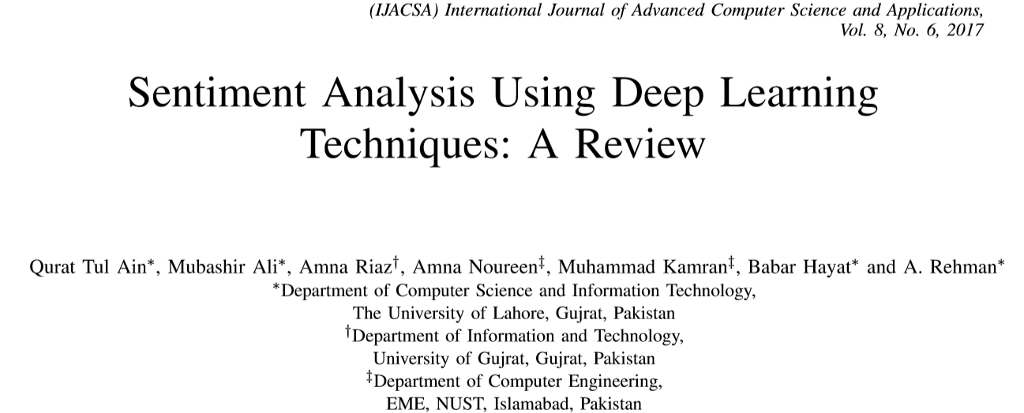
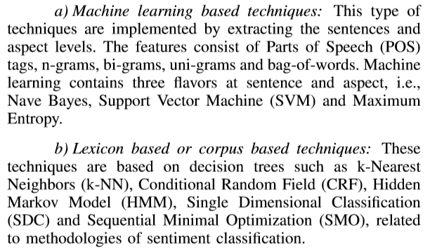

Slide 21
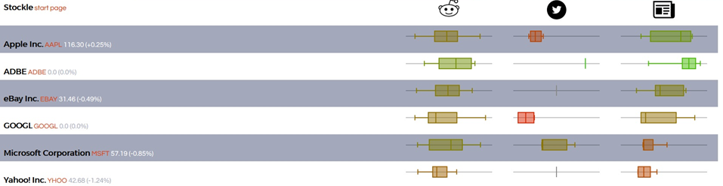
Sentiment Analysis with Feedback

Slide 22
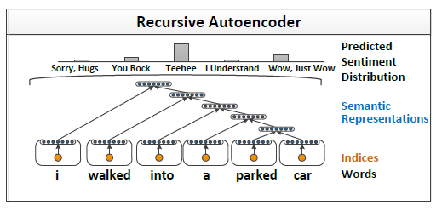
Recursive Neural Networks (RecursiveNN) (Socher, R., et al., 2011b)
These models are recursive auto-encoders which learn seman-
tic vector representations of phrases. Word indices (orange)
are first mapped into a semantic vector space (blue).
Then they are recursively
merged by the same auto-
encoder network into a
fixed length sentence
representation. The vectors
at each node are used as
features to predict a
distribution over text
labels.

Slide 23
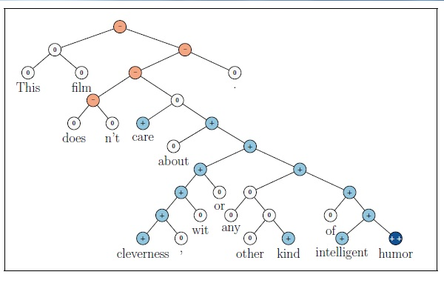
Recursive Neural Tensor Networks (RNTN) (Socher, R., et al. 2013)
The Stanford Sentiment Treebank is the first corpus with fully labeled parse trees that allows for a complete analysis of the compositional effects of sentiment in language.
RNTNs compute parent
vectors in a bottom up
fashion using a compo-
sitionality function and
use node vectors as
features for a classifier
at that node.

Slide 24
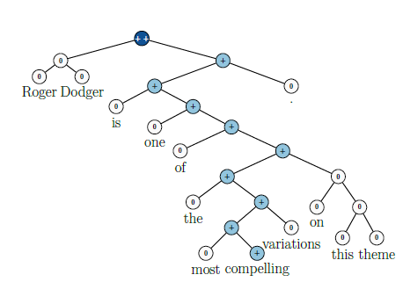
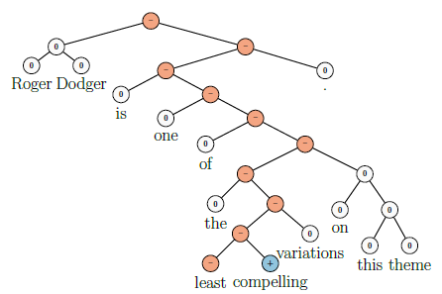
RNTN – Upside and Downside
RNTNS are very efficient in terms of constructing sentence representations.
RNTNs capture the semantics of a sentence via a tree structure. Its performance heavily depends on the performance of the textual tree construction.
Constructing such a textual tree exhibits a time complexity of at least O(n2), where n is the length of the text.
RNTNs are unsuitable for modeling long sentences or documents.

Slide 25
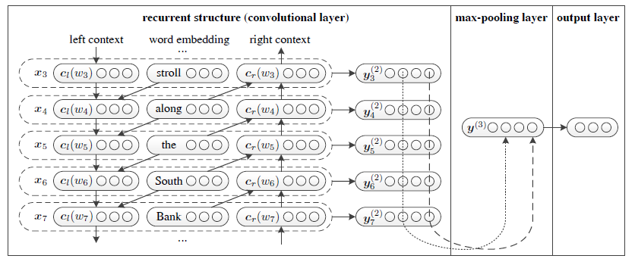
Recurrent Convolutional Neural Networks (RCNN) (Lai, S., et al. 2015)
They adopt a recurrent structure to capture contextual information as far as possible when learning word representations, which may introduce considerably less noise compared to traditional window-based neural networks.
The bi-directional
recurrent structure
of RCNNs.
RCNNs exhibit a
time complexity of
O(n)

Slide 26
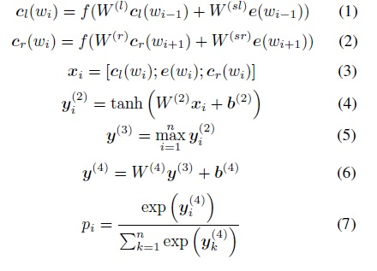
RCNN Equations
RCNNs exhibit a time complexity of O(n) , which is linearly correlated with the length of the text length.
7 equations defining all the
Neural Network topology
Input length can be variable

Slide 27
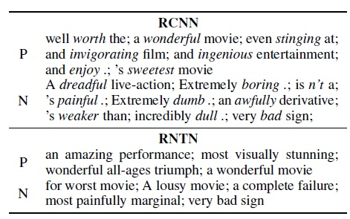
RCNN: Feature Extraction
RCNNs employ a max-pooling layer that automatically judges
which words play key roles in text classification to capture
the key components in texts.
The most important words
are the information most
frequently selected in the
max-pooling layer.
Contrary to the most positive
and most negative phrases
in RNTN, RCNN does not rely
on a syntactic parser, therefore, the presented n-grams are not
typically “phrases”.

Slide 28
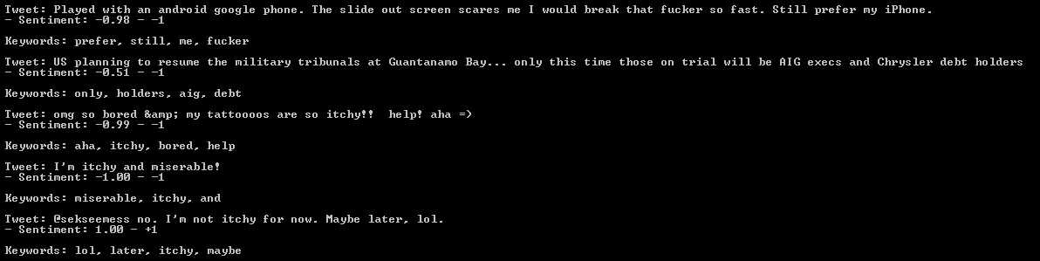
RCNN applied to social networks Sentiment Analysis: Twitter
RCNNs achieve 85% of accuracy on a 1.6 mln tweets training set (800k positive and 800k negative) for the task of Sentiment Analysis. This result is «state-of-art» in twitter sentiment classification.
We can extract most significant keywords and summarize

Slide 29
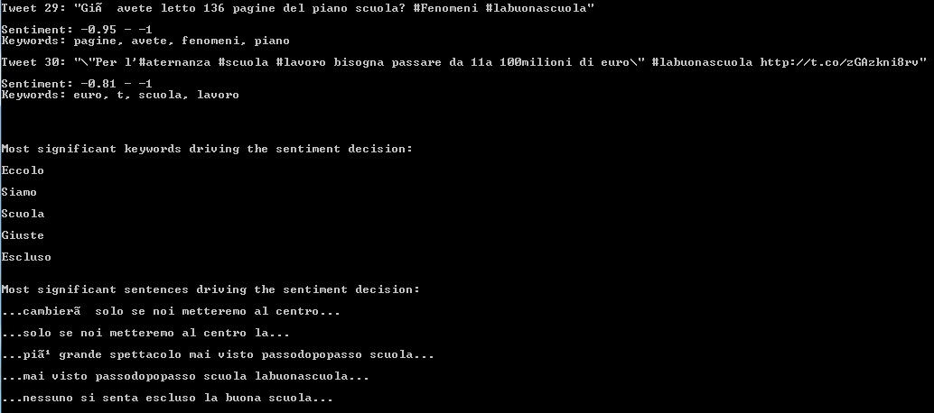
RCNN applied to Extractive Text Summarization
Best keywords lead to best contextes ---> Summarization

Slide 30
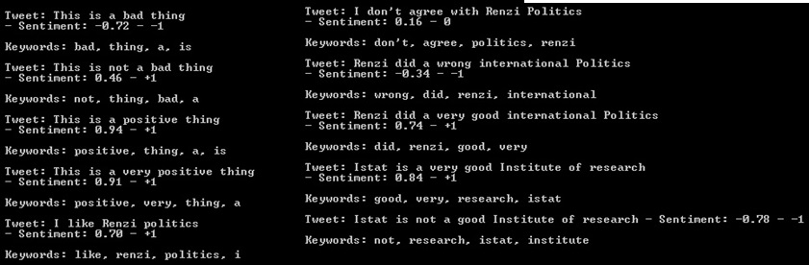
Recurrent Neural Networks are able to understand negations and other things
Thanks to word embeddings semantics RNNs can recognize nagations, and complex forms of language utterances.

Slide 31
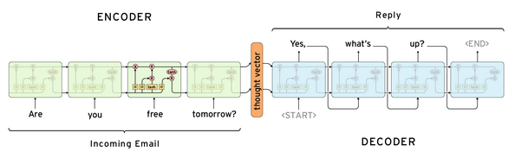
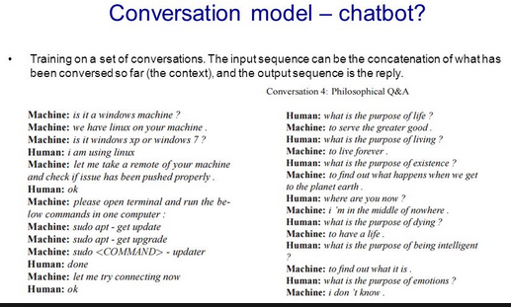
Neural Conversational Models (Vinyals, & Le., 2015).

Slide 32
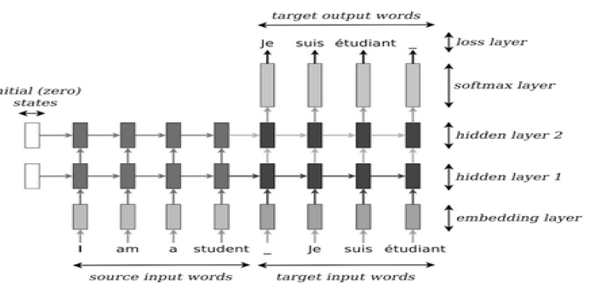
Neural Machine Translation (Bahdanau, et., al., 2014).
Neural machine translation (NMT) is an approach to “machine translation” that uses large ANN to predict the likelihood of a sequence of words, typically modeling entire sentences in a single integrated model (Bahdanau et al., 2014; Luong et Manning, 2016). .

Slide 33

Multilingual Sentiment Analysis (Testi, M., Mercuri, A., & Pugliese, F. Multilingual Sentiment Analysis. JADT’18, 780.)
During the training stage, the RCNN achieves 84% of accuracy on a validation set (selected at the 20% of the original dataset). On a test set of 380 tweets (provided by Semeval), the model returns around 82% of accuracy on positive tweets and 78% of accuracy on negatives, with an approximative 80% overall on a mixed tweets set.
During the training we
determined 3.2 millions
of keywords, namely 2 for
each tweet, the most
important and the second
in order of signinificancy.

Slide 34

Contextual Translations Web-sites

Slide 35
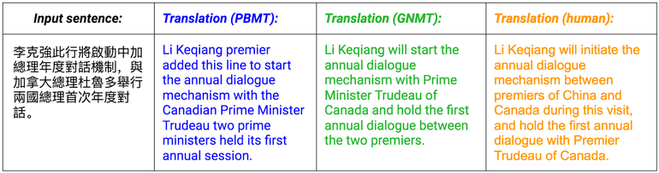
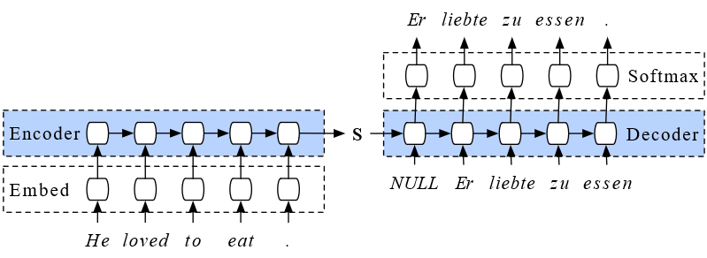
Neural Machine Translation

Slide 36
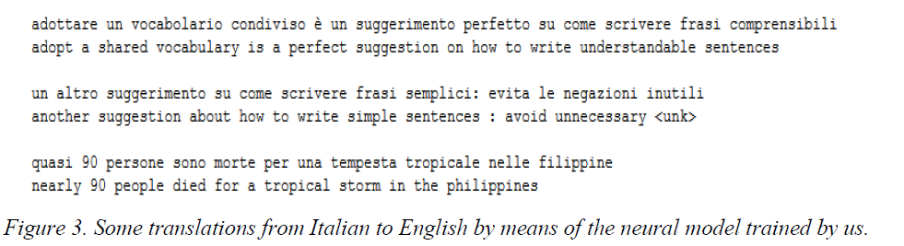
Neural Machine Translation
We have tested the English RCNN model on the same italian SENTIPOLC 2016 test-set translated into English by our neural machine translation model. Results highlight a boost of performance : 78% of accuracy on the test set versus the 43% of the Italian trained RCNN model proving our strategy of stacking NMT and RCNN models is successful.

Slide 37
REFERENCES
Scott, A. J., & Knott, M. (1974). A cluster analysis method for grouping means in the analysis of variance. Biometrics, 507-512.
Vinyals, O., & Le, Q. (2015). A neural conversational model. arXiv preprint arXiv:1506.05869.
Bahdanau, D., Cho, K., & Bengio, Y. (2014). Neural machine translation by jointly learning to align and translate. arXiv preprint arXiv:1409.0473.
Sutskever I, Hinton GE (2008). Deep, narrow sigmoid belief networks are universal approximators. Neural Computation. 20(11):2629–36. pmid:18533819
Roux NL, Bengio Y. (2010) Deep Belief Networks Are Compact Universal Approximators. Neural Computation.22(8):2192–207.
Amari, S. I., Cichocki, A., & Yang, H. H. (1995, December). Recurrent neural networks for blind separation of sources. In Proc. Int. Symp. NOLTA (pp. 37-42).
Chung, J., Gulcehre, C., Cho, K., & Bengio, Y. (2014). Empirical evaluation of gated recurrent neural networks on sequence modeling. arXiv preprint arXiv:1412.3555.
Hochreiter S, Schmidhuber J. Long Short-Term Memory (1997). Neural Computation. 1997;9(8):1735–80. pmid:9377276
.

Slide 38
REFERENCES
Bliemel F. Theil's (1973) Forecast Accuracy Coefficient: A Clarification. Journal of Marketing Research. 10(4):444.
Kumar, A., Irsoy, O., Ondruska, P., Iyyer, M., Bradbury, J., Gulrajani, I., ... & Socher, R. (2016, June). Ask me anything: Dynamic memory networks for natural language processing. In International Conference on Machine Learning (pp. 1378-1387).
Bow, C., Hughes, B., & Bird, S. (2003, July). Towards a general model of interlinear text. In Proceedings of EMELD workshop (pp. 11-13).
Mikolov, T., Sutskever, I., Chen, K., Corrado, G. S., & Dean, J. (2013). Distributed representations of words and phrases and their compositionality. In Advances in neural information processing systems (pp. 3111-3119).
Goodfellow, I., Pouget-Abadie, J., Mirza, M., Xu, B., Warde-Farley, D., Ozair, S., ... & Bengio, Y. (2014). Generative adversarial nets. In Advances in neural information processing systems (pp. 2672-2680).
Salimans, T., Goodfellow, I., Zaremba, W., Cheung, V., Radford, A., & Chen, X. (2016). Improved techniques for training gans. In Advances in Neural Information Processing Systems (pp. 2234-2242).
.

Slide 39

AKNOWLEDGEMENTS
THANK YOU
FOR YOUR ATTENTION
Francesco Pugliese

